Slide 1
Functions
Session 9

Slide 2
Objectives
Explain the use of functions
Explain the structure of a function
Explain function declaration and function prototypes
Explain the different types of variables
Explain how to call functions
Call by Value
Call by Reference
Explain the scope rules for a function
Explain functions in multifile programs
Explain Storage classes
Explain function pointers

Slide 3
Functions
A function is a self-contained program segment that carries out a specific, well-defined task
Functions are generally used as abbreviations for a series of
instructions that are to be executed more than once
Functions are easy to write and understand
Debugging the program becomes easier as the structure of the
program is more apparent, due to its modular form
Programs containing functions are also easier to maintain,
because modifications, if required, are confined to certain
functions within the program

Slide 4

The Function Structure
The general syntax of a function in C is :
The type_specifier specifies the data type of the value, which
the function will return.
A valid function name is to be assigned to identify the
function
Arguments appearing in parentheses are also termed as
formal parameters.

Slide 5
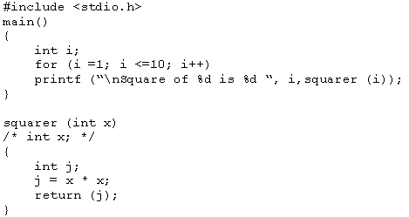
Arguments of a function
Actual Arguments
Formal Arguments
The program calculates the square of numbers from 1 to 10
The data is passed from the main() to the squarer() function
The function works on data using arguments

Slide 6
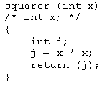
Returning from the function
It transfers the control from the function back to the calling program immediately.
Whatever is inside the parentheses following the return
statement is returned as a value to the calling program.

Slide 7
Data Type of a Function
The type_specifier is not written prior to the function
squarer(), because squarer() returns an integer type value
The type_specifier is not compulsory if an integer type of
value is returned or if no value is returned
However, to avoid inconsistencies, a data type should be
specified

Slide 8
Invoking a Function
A semicolon is used at the end of the statement when a
function is called, but not after the function definition
Parentheses are compulsory after the function name,
irrespective of whether the function has arguments or not
Only one value can be returned by a function
The program can have more than one function
The function that calls another function is known as the calling function/routine
The function being called is known as the called function/routine

Slide 9
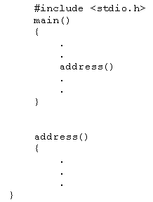
Function Declaration
Declaring a function becomes compulsory when the function is
being used before its definition
The address() function is called
before it is defined
Some C compilers return an error, if the function is not declared before calling
This is sometimes referred to as Implicit declaration

Slide 10
Function Prototypes
Specifies the data types of the arguments
char abc(int x, nt y);
Advantage :
Any illegal type conversions between the arguments used to call a function and the type definition of its parameters is reported
char noparam (void);

Slide 11
Variables
Local Variables
  Declared inside a function
  Created upon entry into a block and destroyed upon exit from the block
Formal Parameters
  Declared in the definition of function as parameters
  Act like any local variable inside a function
Global Variables
  Declared outside all functions
  Holds value throughout the execution of the program

Slide 12
Storage Classes-1
Every C variable has a characteristic called as a storage class
The storage class defines two characteristics of the variable:
Lifetime – The lifetime of a variable is the length of time it retains a particular value
Visibility – The visibility of a variable defines the parts of a program that will be able to recognize the variable

Slide 13
Storage Classes-2
automatic
external
static
register

Slide 14
Function Scope rules
Scope Rules - Rules that govern whether one piece of code knows about or has access to another piece of code or data
The code within a function is private or local to that function
Two functions have different scopes
Two Functions are at the same scope level
One function cannot be defined within another function

Slide 15
Calling The Functions
Call by value
Call by reference

Slide 16
Calling By Value
In C, by default, all function arguments are passed by value
When arguments are passed to the called function, the values are passed through temporary variables
All manipulations are done on these temporary variables only
The arguments are said to be passed by value when the value of the variable are passed to the called function and any alteration on this value has no effect on the original value of the passed variable

Slide 17
Calling By Reference
In call by reference, the function is allowed access to the actual memory location of the argument and therefore can change the value of the arguments of the calling routine
Definition
  getstr(char *ptr_str, int *ptr_int);
Call
getstr(pstr, &var);

Slide 18
Nesting Function Calls
main()
{
.
.
palindrome();
.
.
}
palindrome()
{
.
.
getstr();
reverse();
cmp();
.
.
}

Slide 19
Functions in Multifile Programs
Functions can also be defined as static or external
Static functions are recognized only within the program file and their scope does not extend outside the program file
static fn _type fn_name (argument list);
External function are recognized through all the files of the program
  extern fn_type fn_name (argument list);

Slide 20
Function Pointers
Address is the entry point of the function
Function has a physical location in memory that can be assigned to a pointer
#include <stdio.h>
#include <string.h>
void check(char *a, char *b, int (*cmp)());
main()
{
char sl[80];
int (*p)();
p = strcmp;
gets(s1);
gets(s2);
check(s1, s2, p);
}
void check(char *a, char *b, int (*cmp)())
{
printf(“testing for equality \n”);
if (!(*cmp)(a,b))
printf(“Equal”);
else
printf(“Not Equal”);
}

